Slide 1





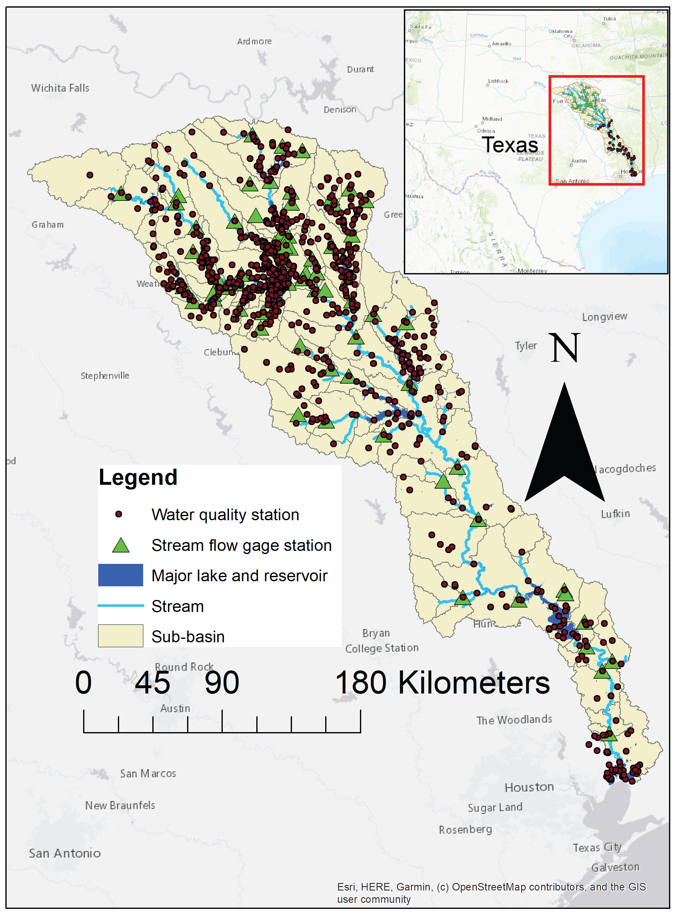
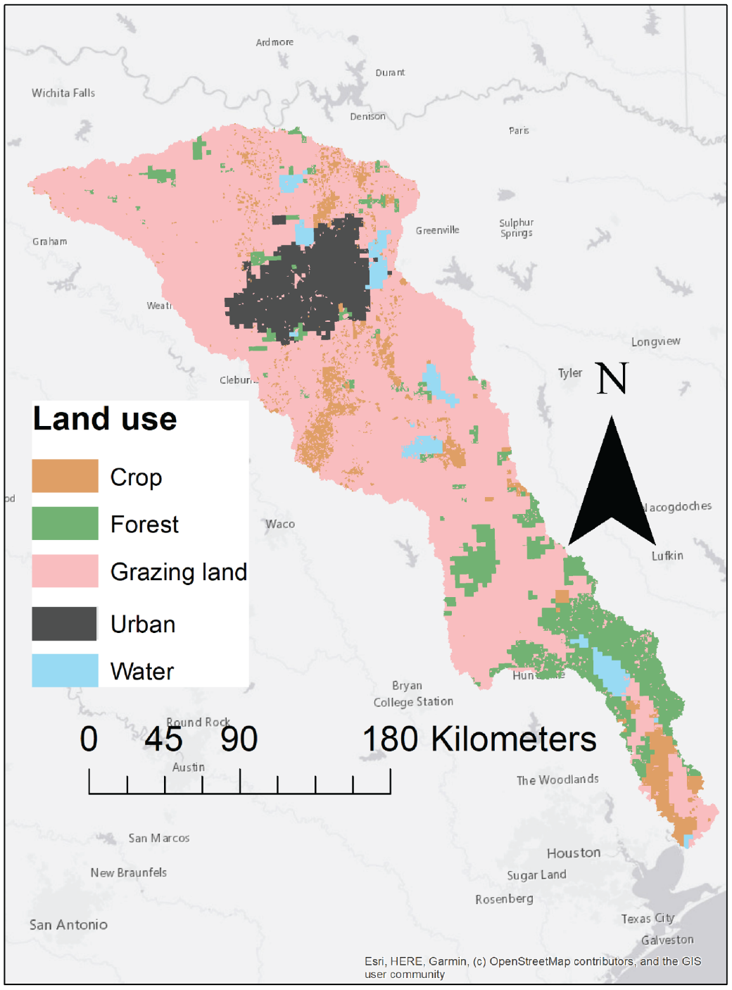


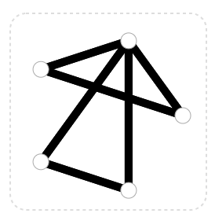
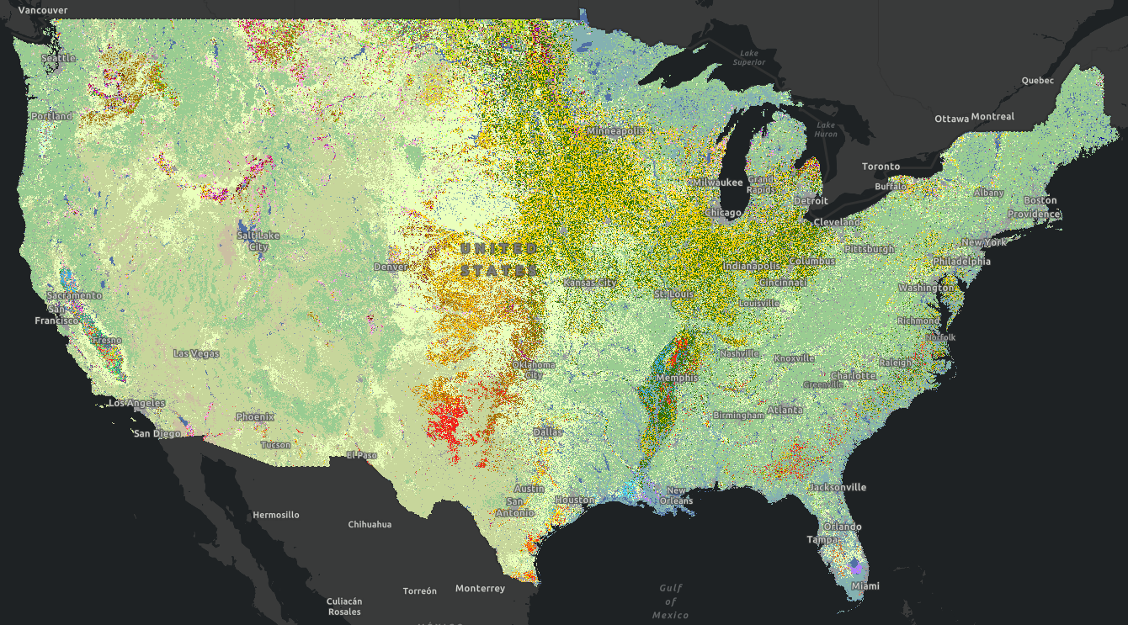
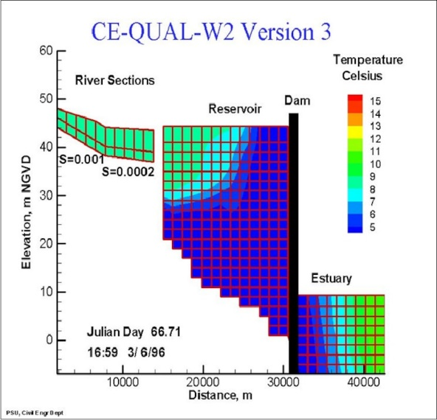
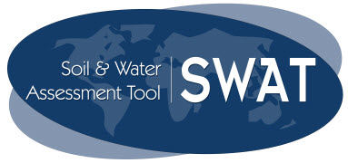
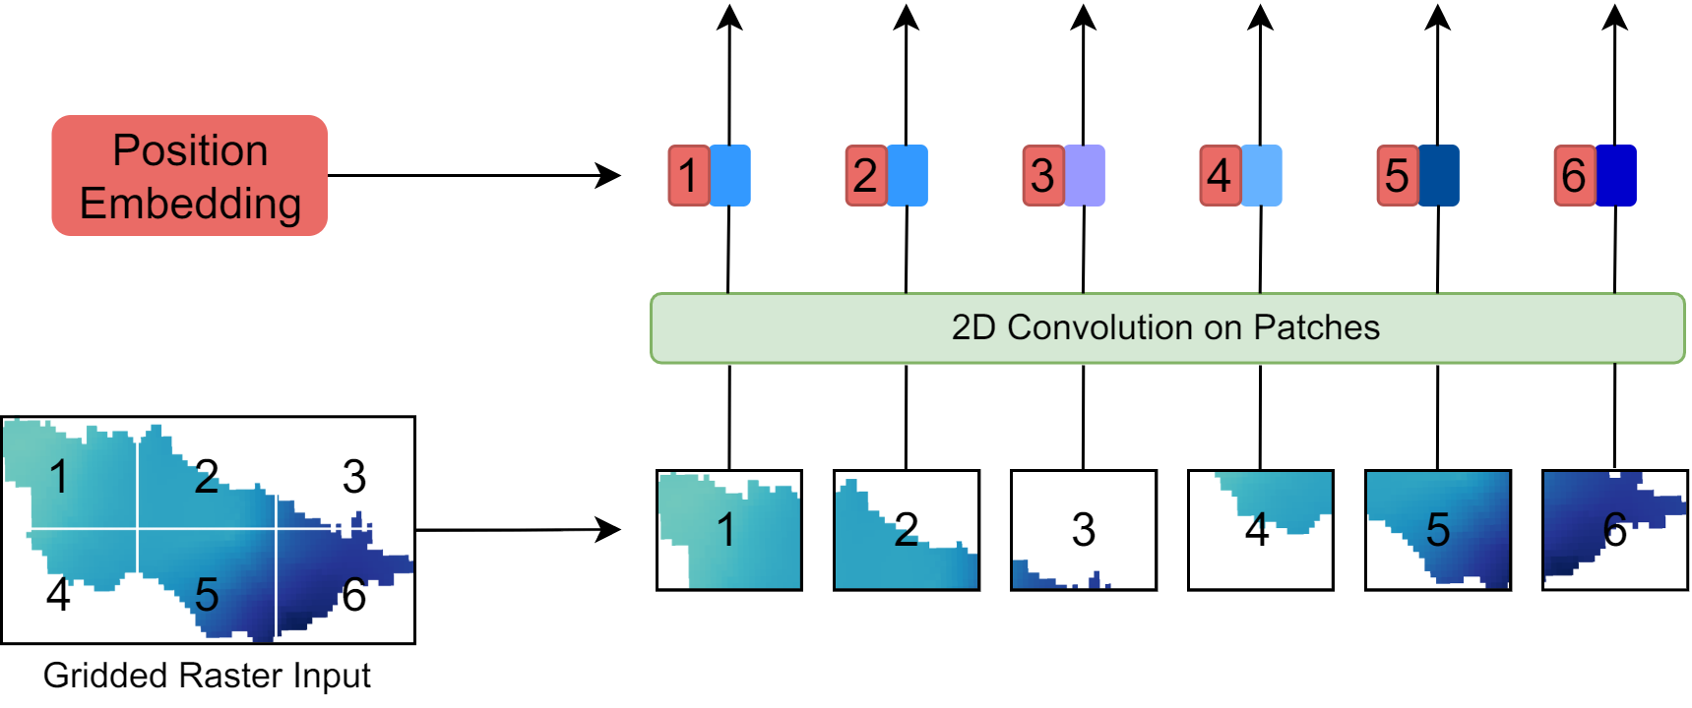
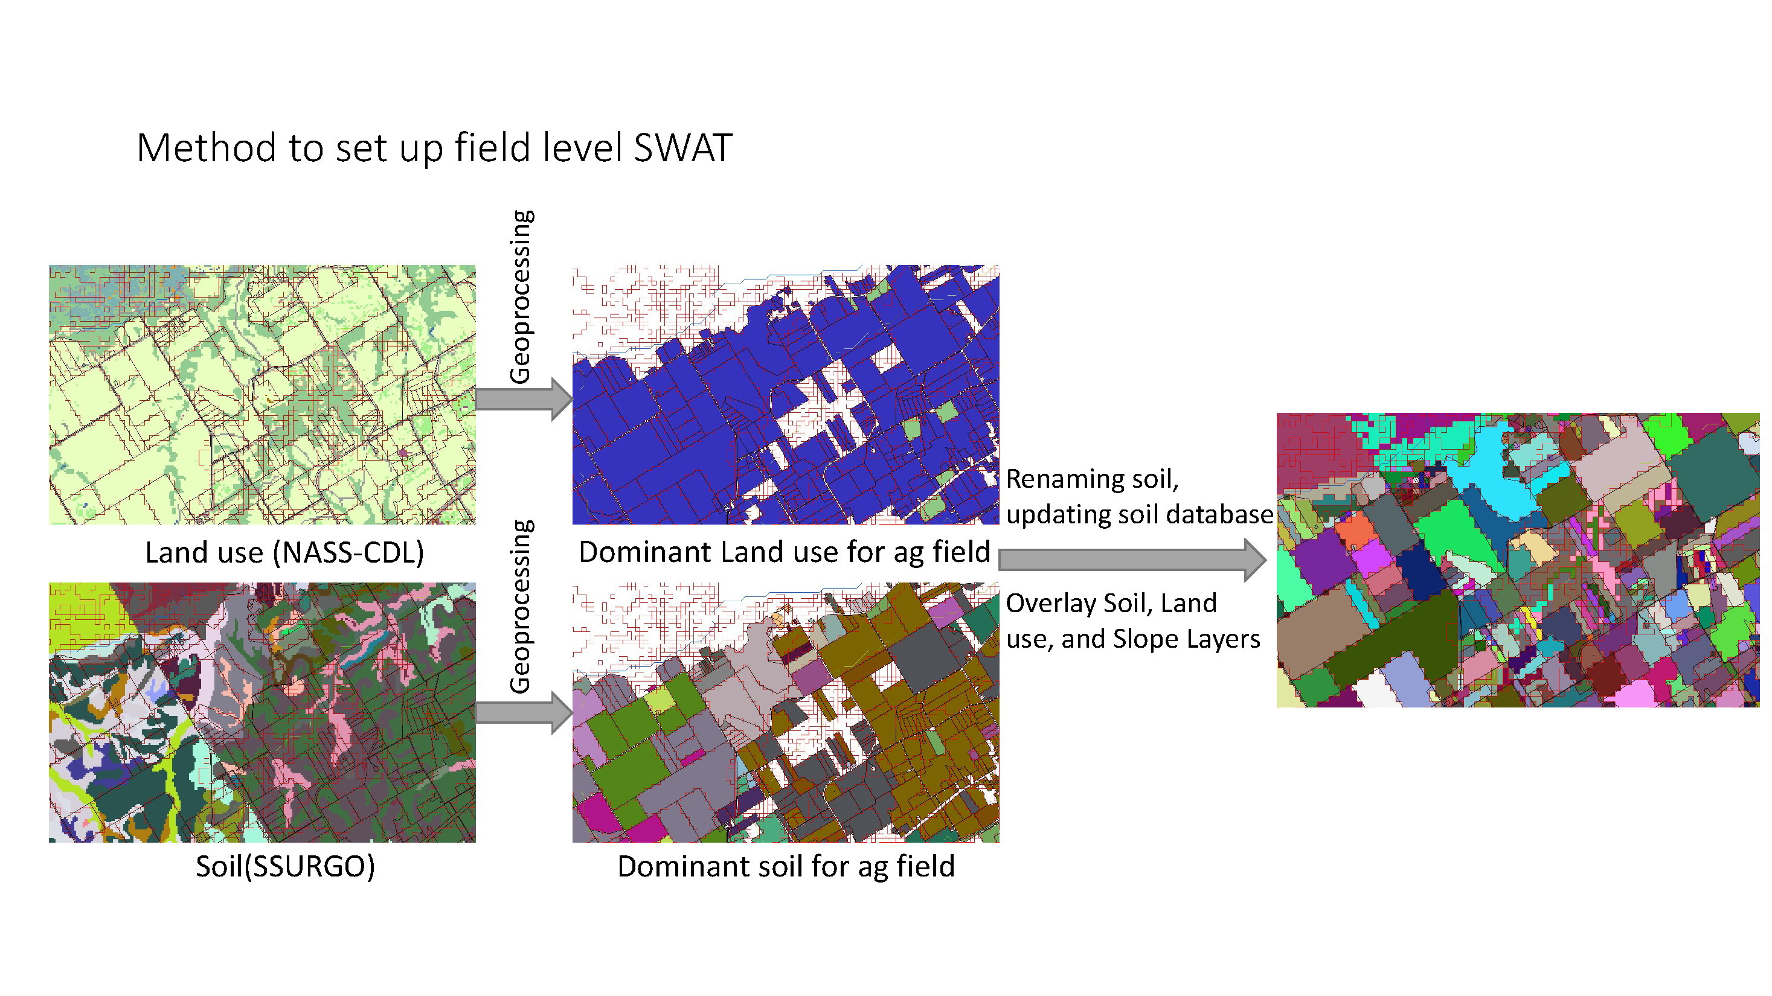
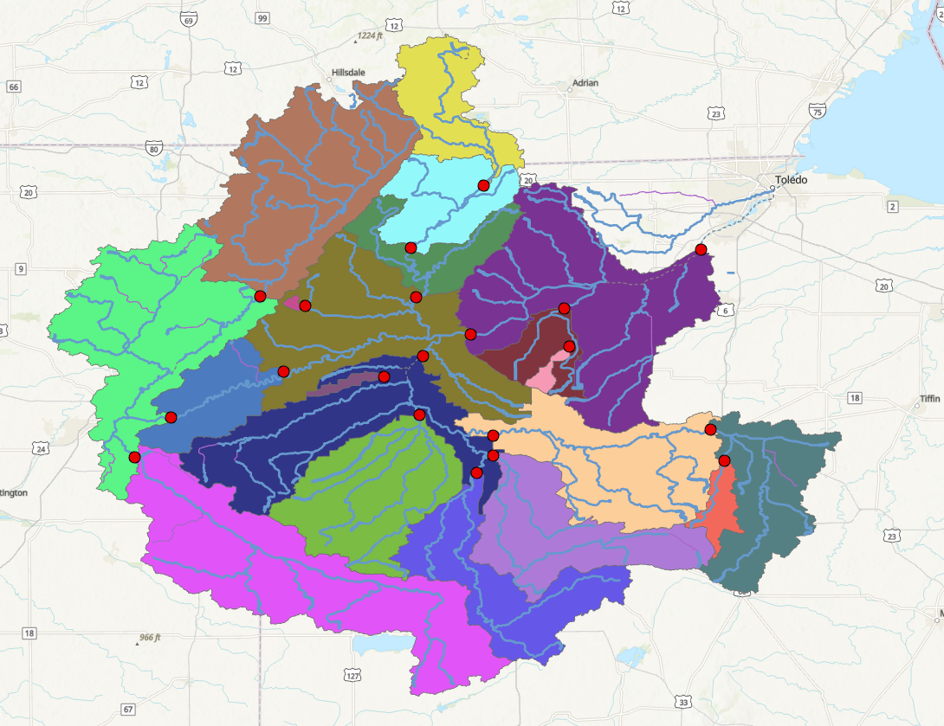
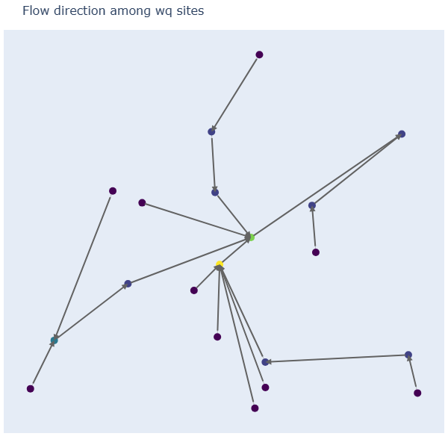
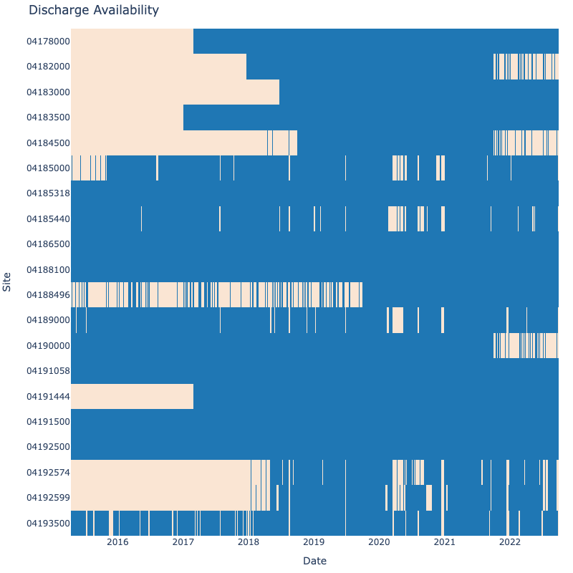
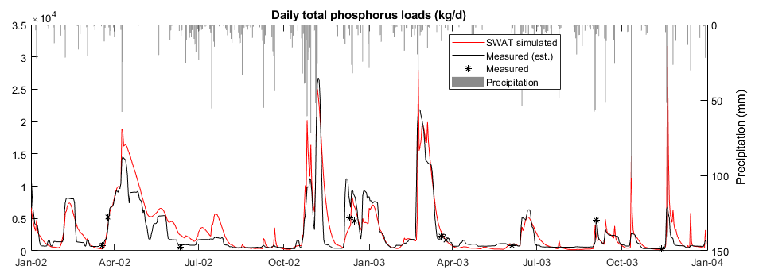
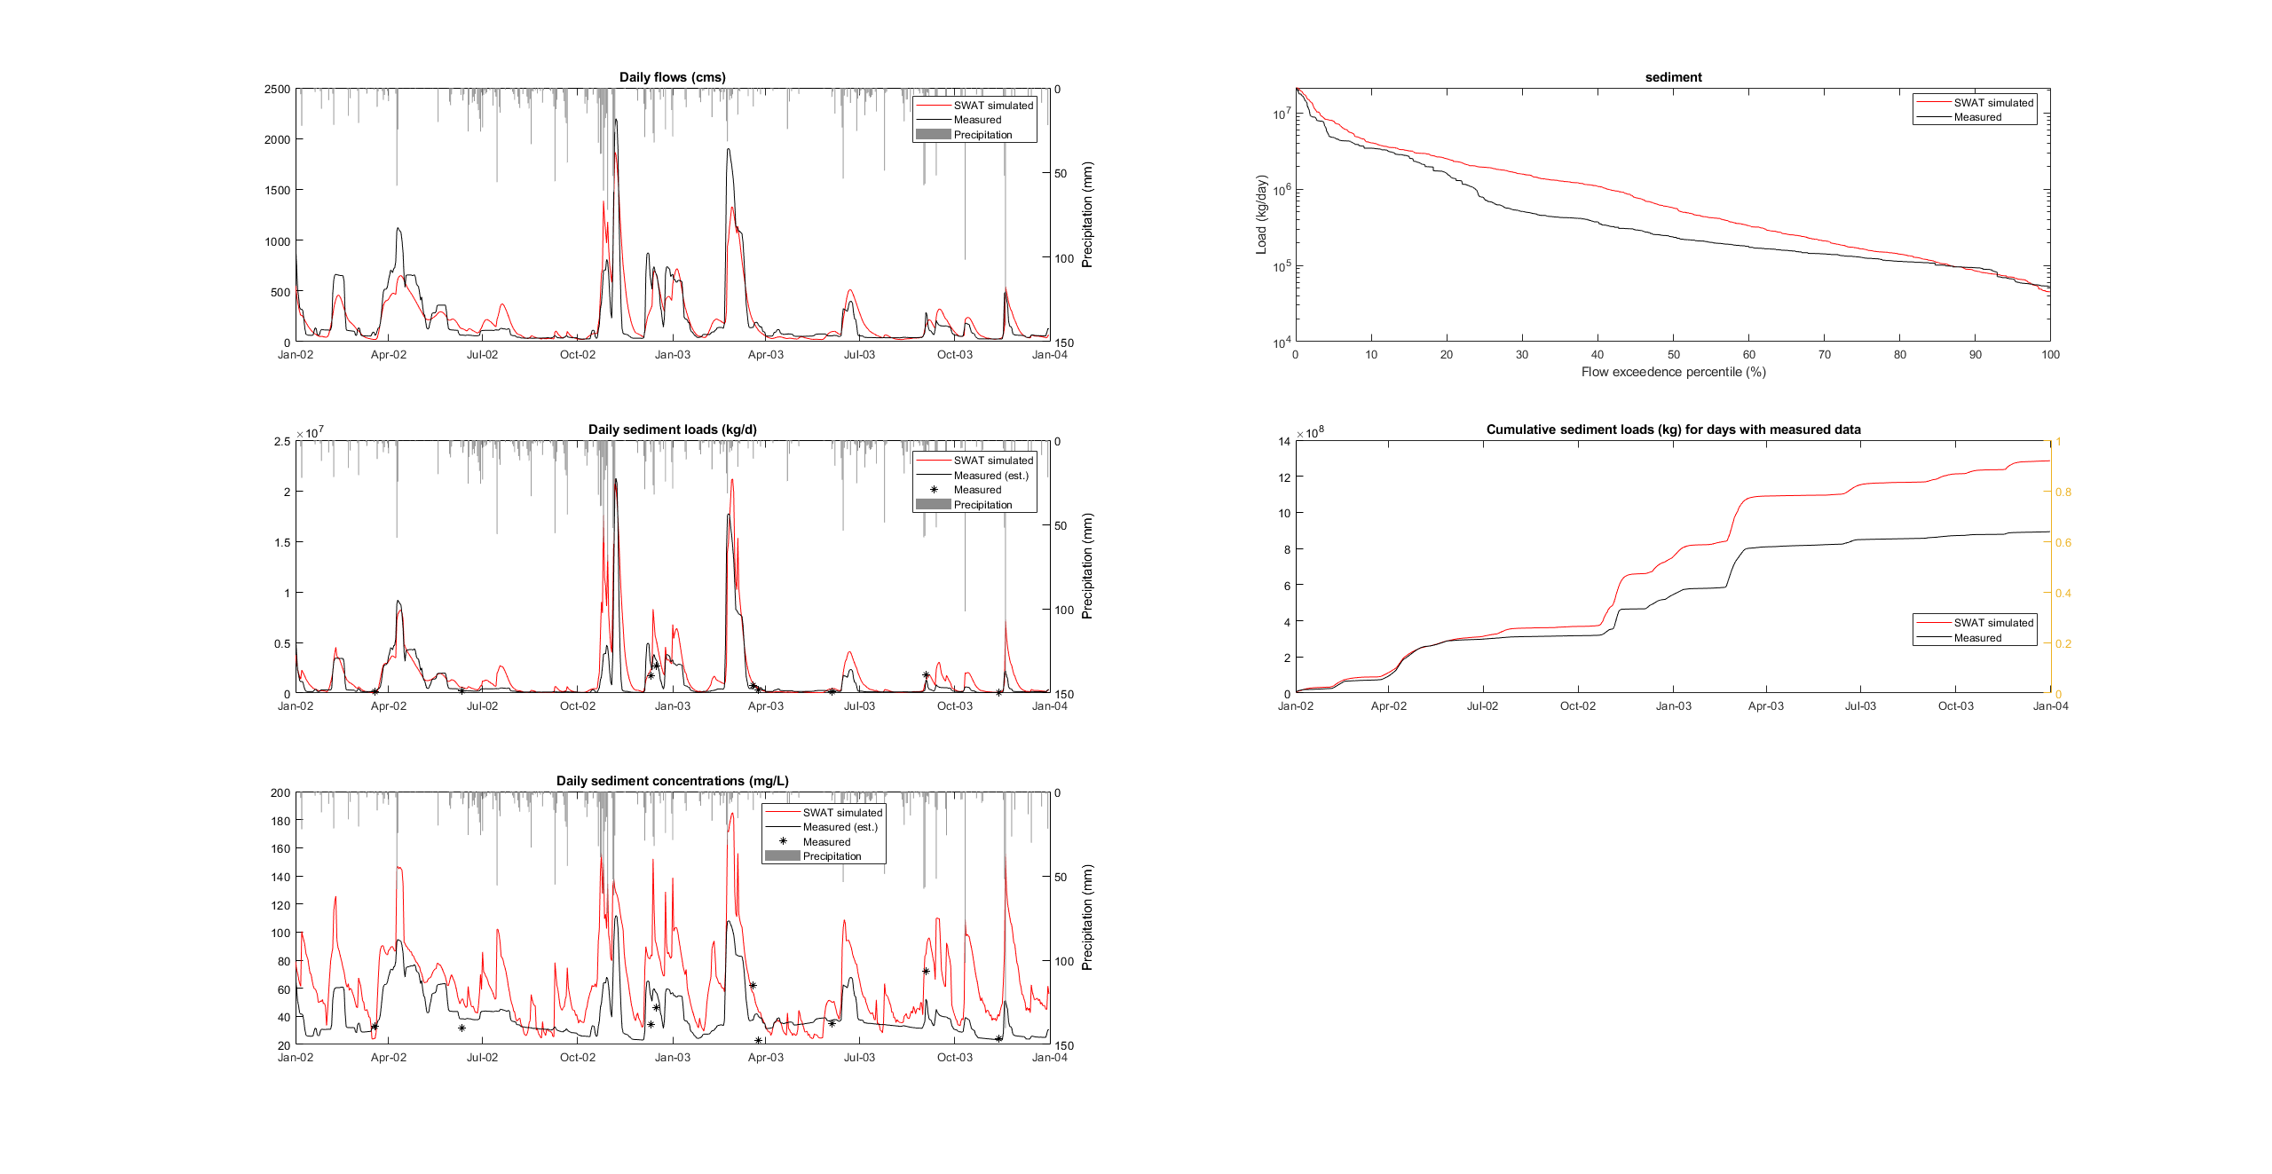
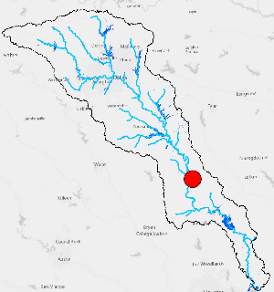
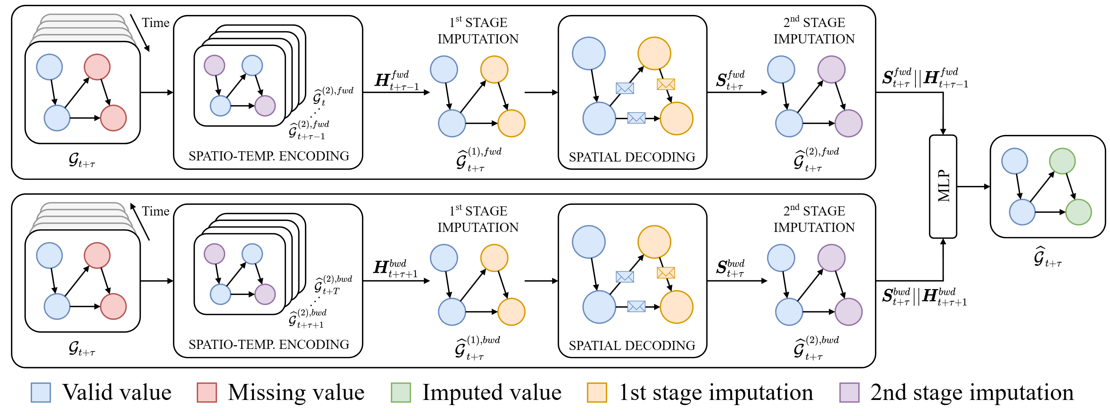
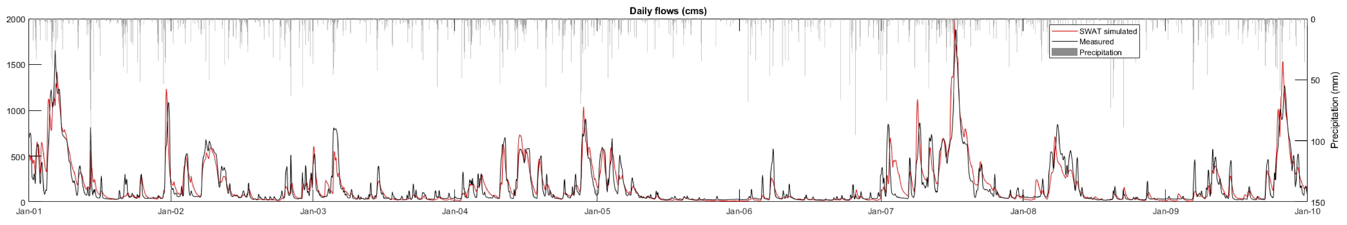
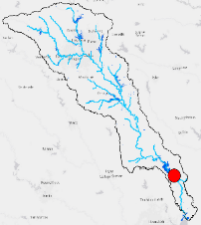
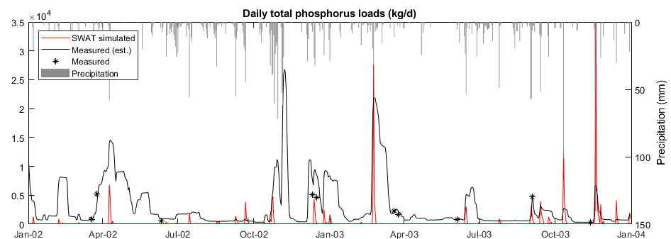
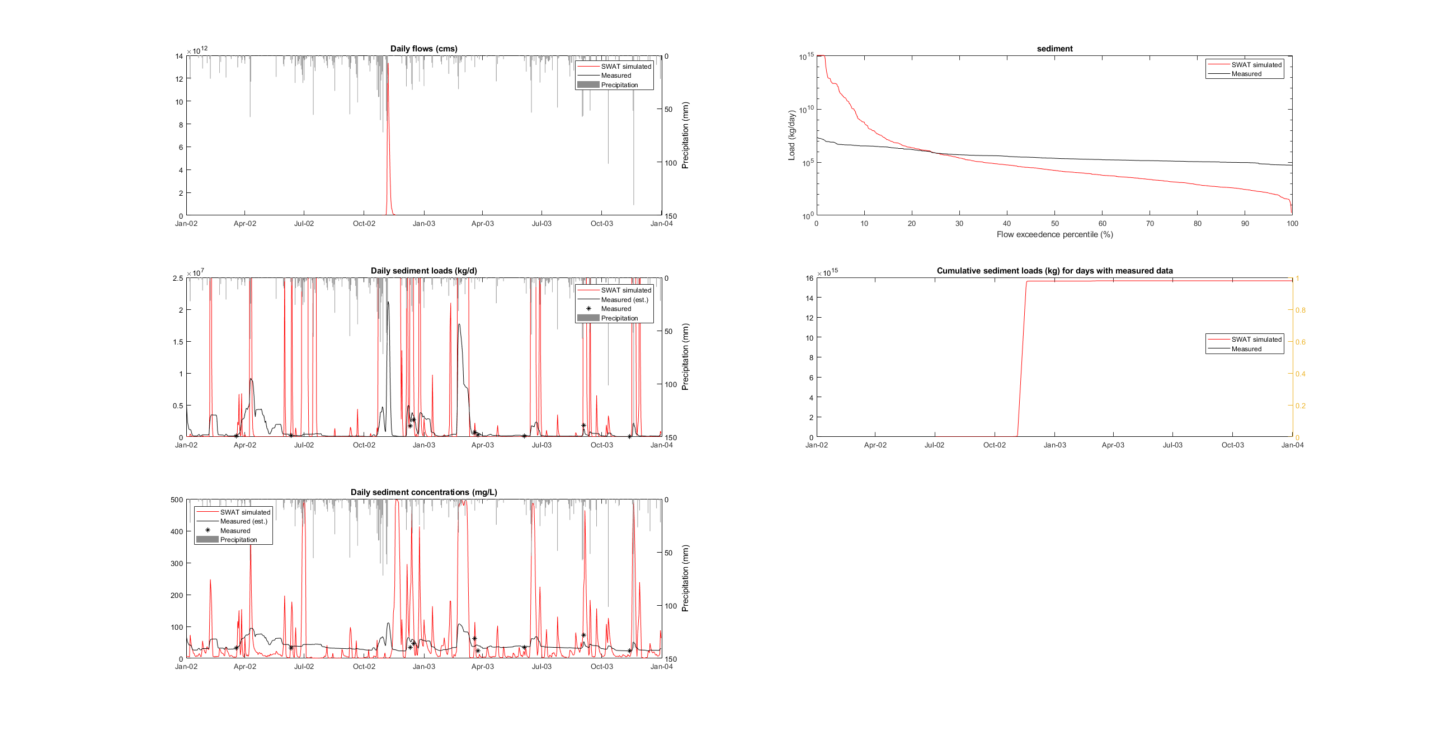
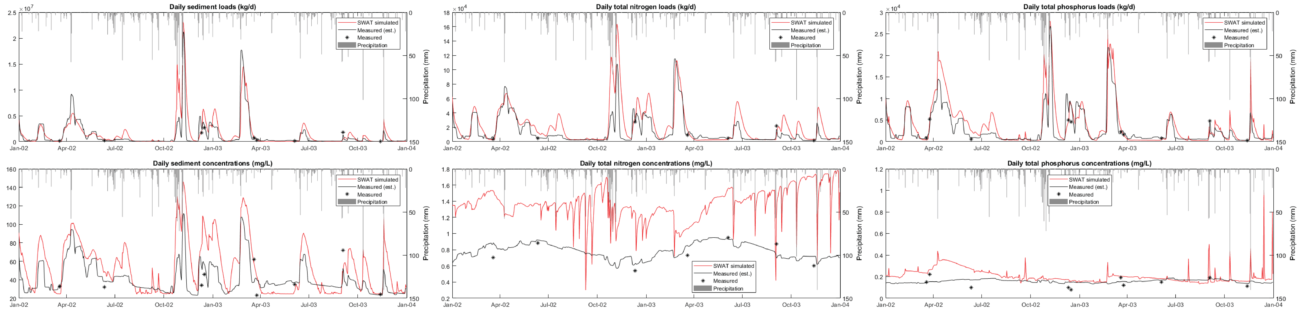
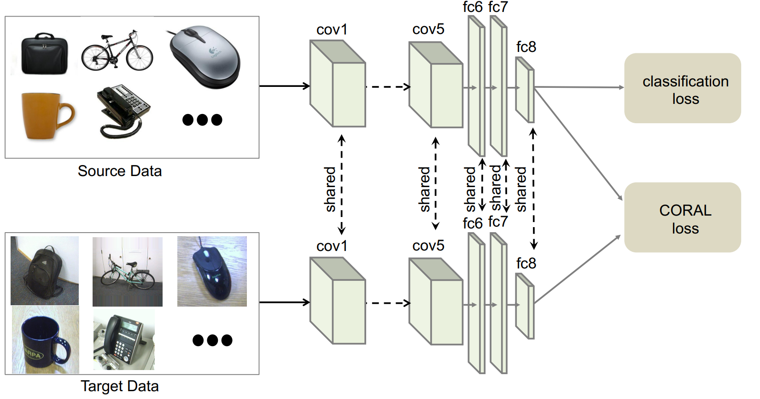
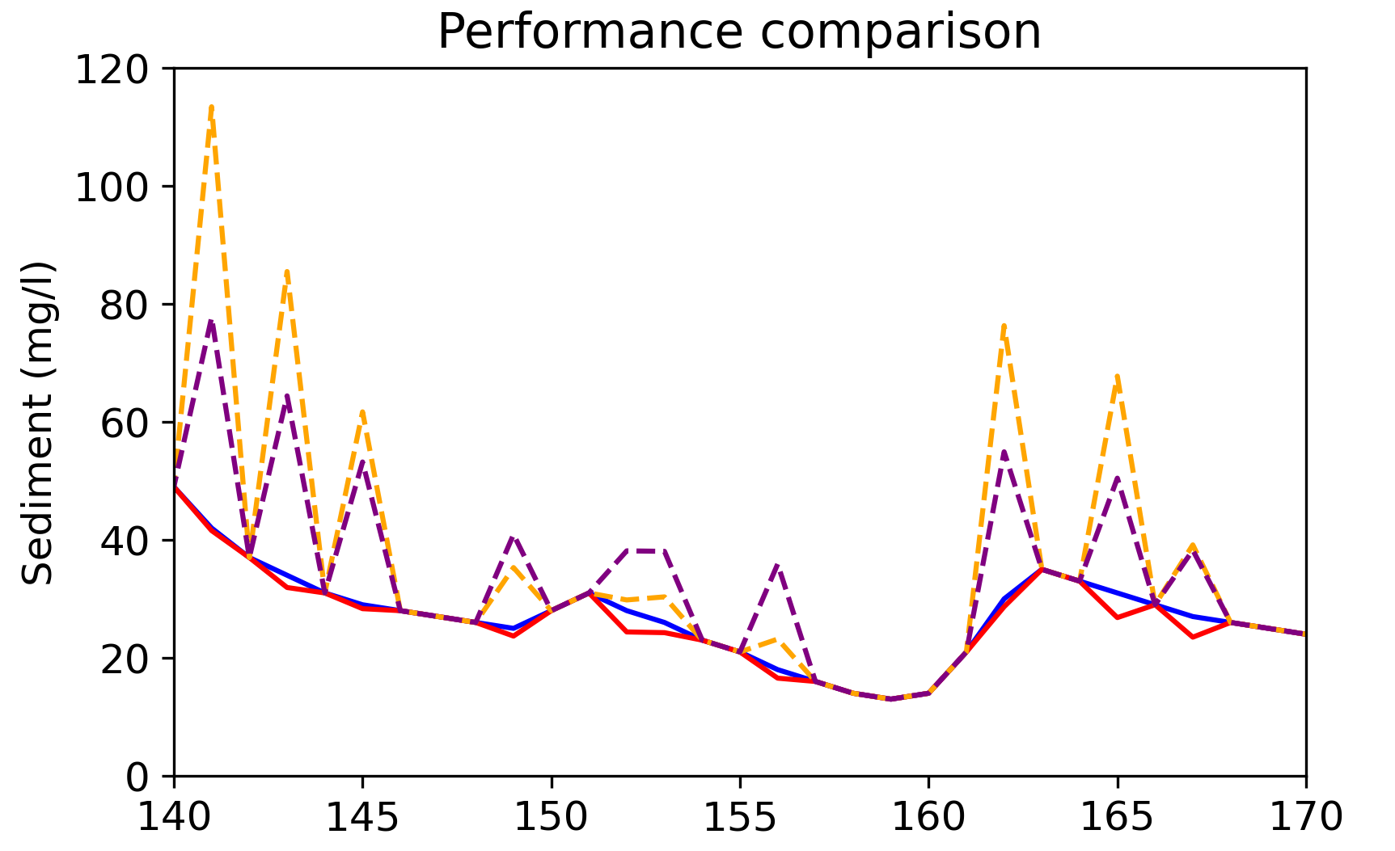
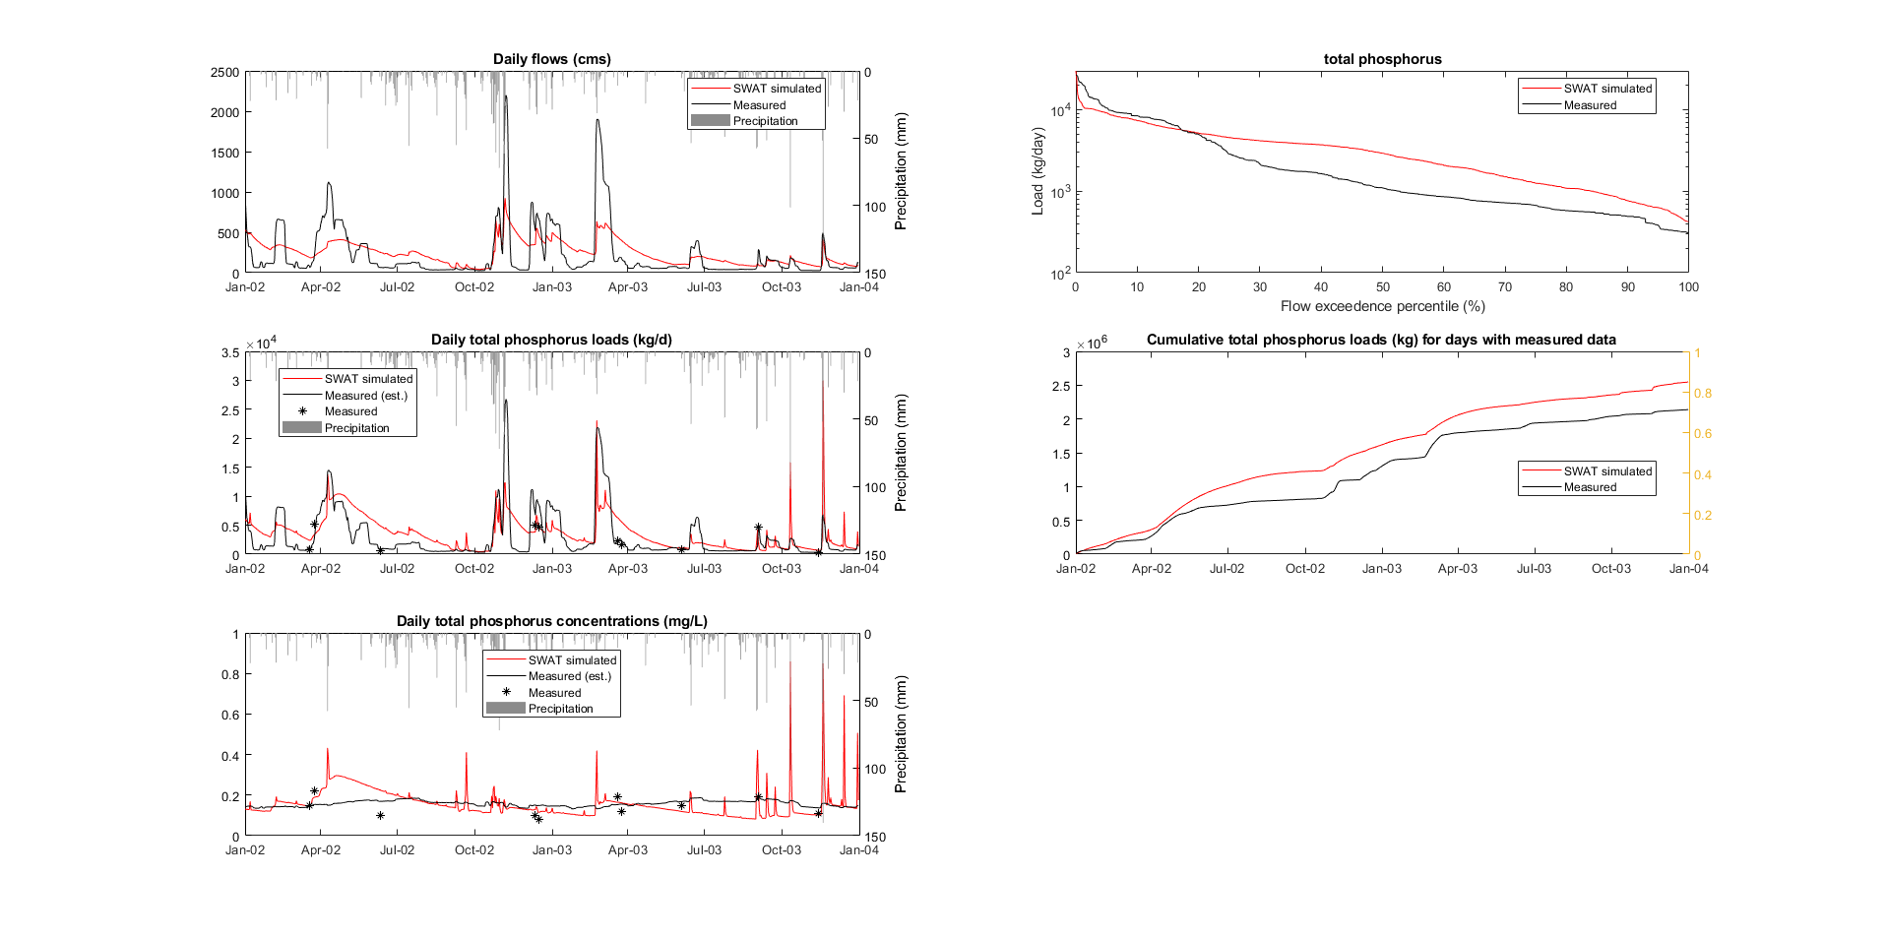
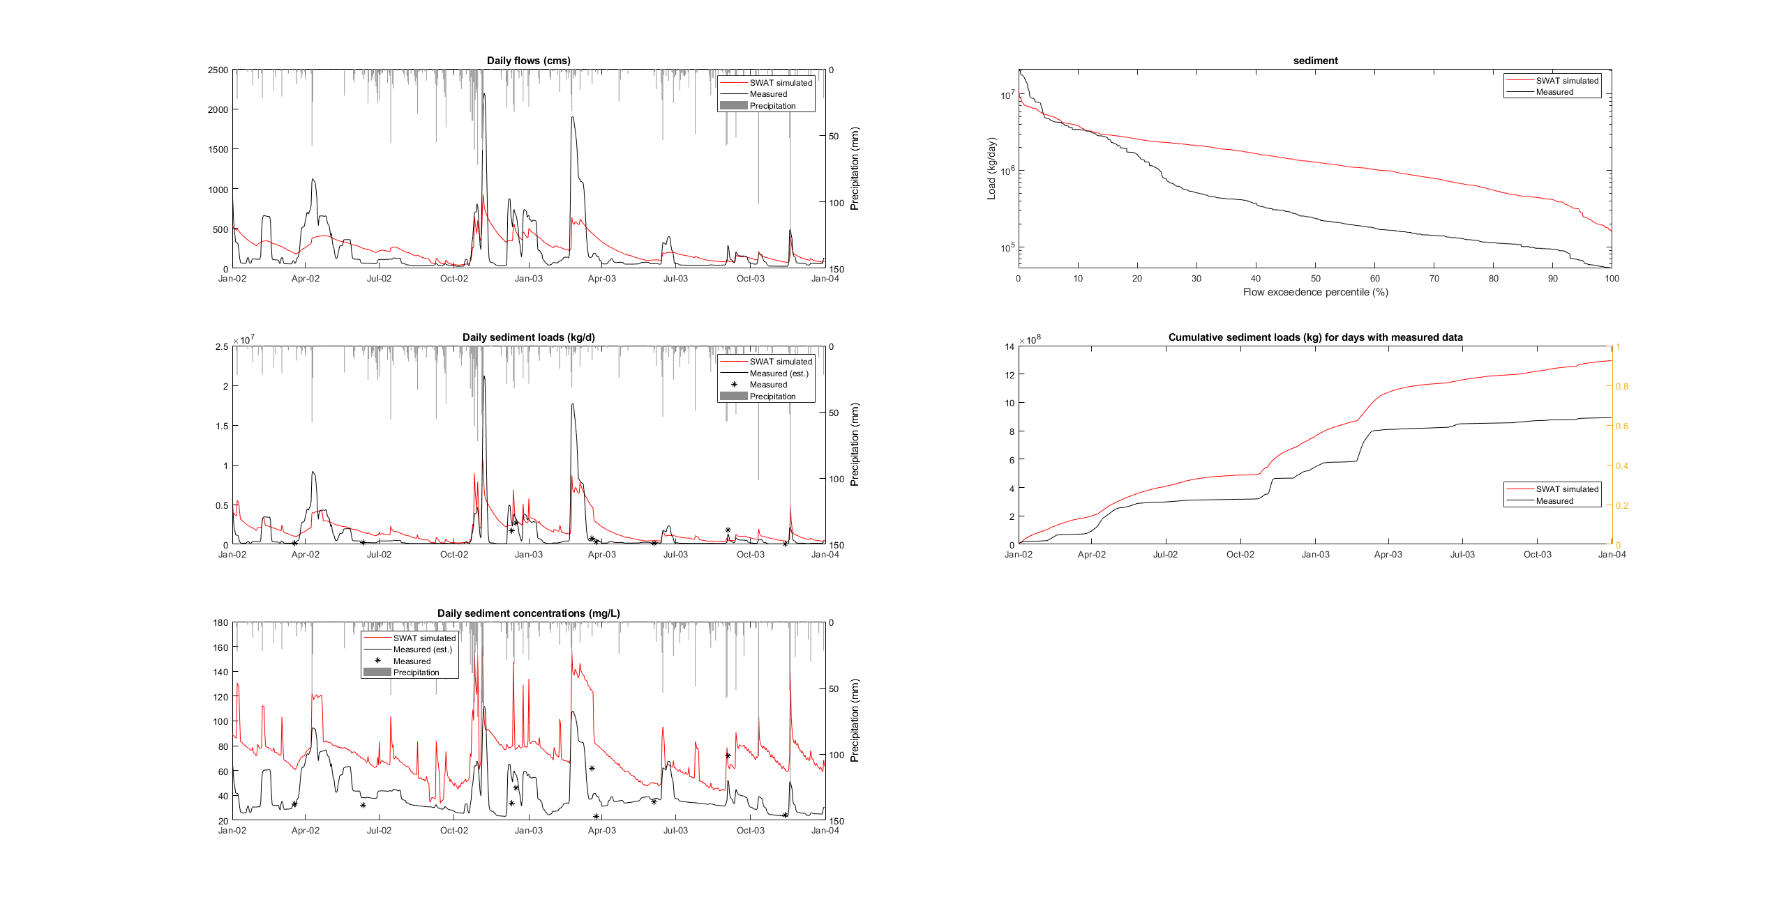
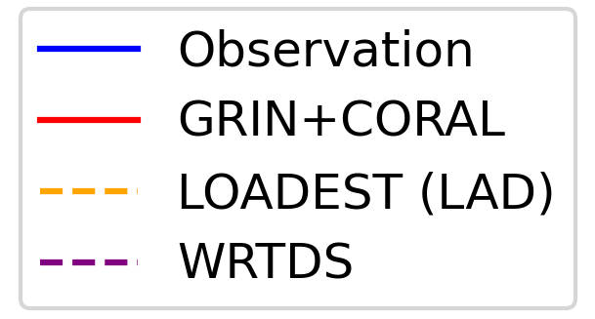
Basin-scale Modeling of Collective Management Practices in Agriculture to Reduce Sediment and Nutrient Inputs into Flood-Control and Drinking Water Reservoirs
Ting Liu¹, Qi Deng, Yuhang Wei, Paras Sheth, Kaize Ding, John L Sabo, Rebecca Logsdon Muenich² Contact: 1. tingl@uark.edu 2. rlogsdo@uark.edu
1. Introduction
2. Project overview
3. Study area
Reservoirs are an essential control on the hydrologic regime and subsequent water quality
Reservoir management primarily supports water quantity needs, while quality is often not the primary goal^{[1]}
Both agricultural lands and reservoirs can be a source or sink for pollutants and may also be users, generators, or storage parcels for large quantities of water^{[2,3]}
The collective management of these two separate systems may improve water quantity and quality in this integrated system
Agricultural is the top source of nitrogen and phosphorus - EPA
Reservoir operation induced flow change can affect reservoir water quality
a) Monitoring data
Parameter integration
Spatial interpolation
d) National assessment
Trinity River Basin in Texas consists of large areas of urban, grazing lands, and croplands with a total area of 46,732 km². We select this watershed as a working laboratory to explore the collective management between agriculture and reservoirs due to the variety of land use, the heavy water demand in this region, and the water resources management complexity as 15 major reservoirs are located from the upstream to the downstream.
No coordination!
b) Reservoir model
c) Hydrological model
e) Transfer learning
Surface water nutrient pollution
f) Causal learning
3. Base hydrological model (SWAT)
4. GNN for increasing water
quality observations
SWAT Model Development
Input | Data source
Precipitation | NOAA (CDO)
Temperature | NOAA (CDO)
Elevation | USGS
Soil | USDA gSSURGO
Land use | USGS NLCD & USDA CDL
Crop schedule | TX AG Extension
Crop type | USDA CDL
Grazing activity | TX AG Extension
Fertilizer | TX Chemist & TX AG Extension
Irrigation | TX Water Development Board
Manure input | USDA AG Census
Point source | US EPA NPDES
Reservoir operation | USGS
Our model consists of 39,104 HRUs based on land use, soil, and land slope variation. To incorporate the agricultural management into simulations, the resolution of land use and soil data was re-scaled based on the domain of the major agriculture field.
Water quality observation in Trinity River Basin 1990-2021:
21,175 sediment records (34/station, 5.33% daily coverage)
75,596 nitrogen records (126/station, 5.14% daily coverage)
21,175 sediment records (34/station, 5.33% daily coverage)
No tools currently interpolate water quality data from multiple stations in both temporal and spatial dimensions.
Our graph neural network (GNN) approach:
The SWAT model is a physically-based hydrological model that calculates the water balance, surface, and groundwater hydrology at individual hydrological response units (HRU) and then aggregates these lumped quantities to be routed downstream.
a) Pre-define water quality station network
Model Calibration
Water quality change
due to dam control
b) Study flow pattern
Historical dam control
R² = 0.82
NS = 0.81
Blocked data: 25%, point missing
Node: 13 (USGS 04190000 )
Train during: 04/15/2015 – 03/02/2021
Testing during: 03/03/2021 – 09/09/2021
(1) Minimize
reservoir
capacity
c) Transfer flow pattern to water quality pattern
(2) Maximize flood control
5. Framework for studying causal relationships on water quality change
6. Conclusions
Causal learning is used to study the causal relationship between SWAT input and output. We group the daily causal relationships to handle both the spatial and temporal variabilities.
Primary Findings
Confirmed reservoir influence on river water quality.
Applied GNN for water quality monitor data interpolation improves prediction.
Proposed causal learning for the mechanism of water quality change can identify important model components.
Acknowledgment
This work is funded by the Engineering With Nature program in the US Army Corps of Engineers, Award #W912HZ-21-2-0040
Validation:
Numerical validations (cross-validation & data separation)
Classification of data type (soil, land surface, etc.)
Physical-based expert opinions on significance
Ongoing & Future works
Check Danna’s poster (#24) about our national AG-reservoir assessment.
Integrating and interpolating water quality data for hydrological model use.
Finish a full-calibrated SWAT model with an integrated reservoir model by the integrated and improved water quality monitor data.
Building a general applied temporal-spatial causal learning framework.
[1] Xu, Zhihao, et al. "Is water shortage risk decreased at the expense of deteriorating water quality in a large water supply reservoir?." Water research 165 (2019): 114984. [2] Powers, Stephen M., Jennifer L. Tank, and Dale M. Robertson. "Control of nitrogen and phosphorus transport by reservoirs in agricultural landscapes." Biogeochemistry 124.1 (2015): 417-439. [3] HaRa, Jang, Usman Atique, and Kwang-Guk An. "Multiyear links between water chemistry, algal chlorophyll, drought-flood regime, and nutrient enrichment in a morphologically complex reservoir." International journal of environmental research and public health 17.9 (2020): 3139.
Further reading: Sheth et al., 2022. Causal Discovery for Feature Selection in Physical Process-Based Hydrological Systems, in: 2022 IEEE International Conference on Big Data, pp. 5568–5577. https://doi.org/10.1109/BigData55660.2022.10020794

